Slide 1

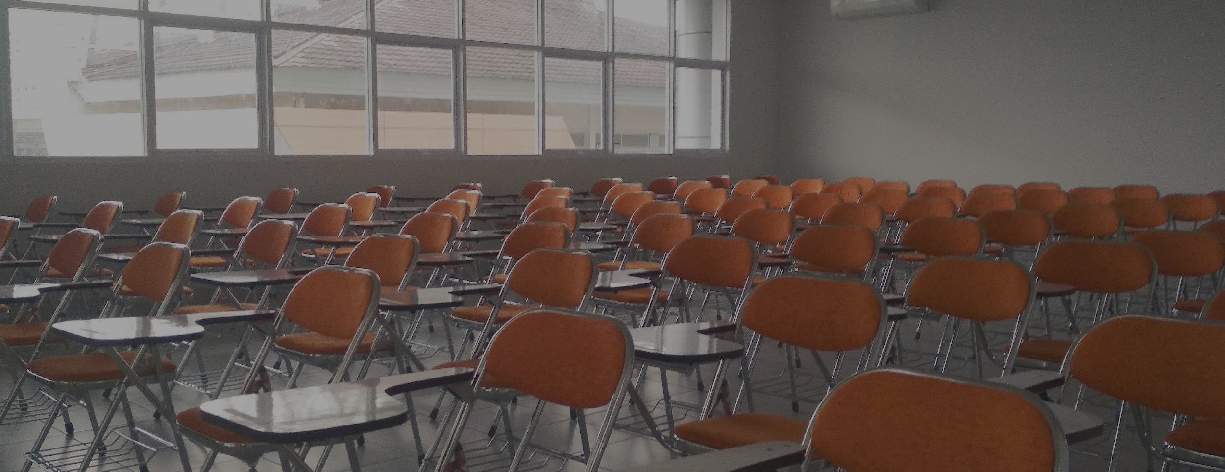

NAPLAN
Machine Learning Investigation
to predict student achievement results
“ Record investment in world class schooling infrastructure not only delivers even better educational services and revitalises how we teach and learn, it also boosts connectivity and access to information and skills for all Queensland communities.”
Notes:
Children across our country sit four tests, four times before they are 14. But what influences the results they get on these tests?
Good evening, my name is Enessa McArthur and thank you for the invitation to our data team to utilise machine learning to investigate and uncover what factors are positively or negatively influencing student achievement and whether this can accurately predict student outcomes.

Slide 2
PRESENTED BY
ENESSA MCARTHUR BILLIE-ODELLE GORE MINH PHUONG NGUYEN & RACHEL DRAYTON
THE BRIEF
DATA INSIGHTS
APP DEVELOPMENT
ANALYSIS & RESULTS
RECOMMENDATIONS
Notes:
Slide 2: Today our team will present our investigation findings and make recommendations based on these.
Billie Odelle Gore will take you through initial stages of working with the data set provided to us and what initial discoveries were made,
Min Nuygen will outline the development of the website app as a tool for key NAPLAN stakeholders to use, and finally
Rachel Drayton will explain our findings and make recommendations to the board about how this approach could be utilised in the future.

Slide 3


Notes:
Slide 3: The brief you provided was clear, as a department and in line with the Equity and Excellence policy, you wanted to know if there was undue influence on students results as areas for potential funding and increased resources. There were multiple factors that had been flagged as potentially negatively or positively affecting outcomes.
This informed some of the questions we started asking in order to interrogate the data. For example, is a student in a very remote community more likely to have lower scores than a student in a metropolitan area? Are students with parents from lower socio-economic backgrounds worse off than students with parents in high level or corporate roles?

Slide 4
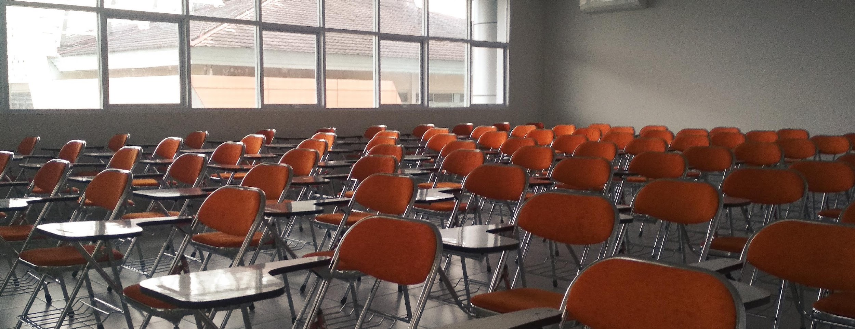
NAPLAN DATA SET
By State
By Year Level
By Calendar Year
By Domain - e.g., Reading, Writing, Grammar, Punctuation and Spelling, Numeracy
By Subgroup - e.g., Gender, Indigenous, Parental Education, language
NMS - National Minimum Standard
Notes:
Using the data set provided we spent some time developing comprehensive understanding of the interrelationships of the factors. As this data didn’t have individual student results we had to break it down into like factors in order to find correlations and look for trends, patterns and draw relationships.
Now I will hand over to Billie to talk further about how we worked with the data set.

Slide 5
DATA PROCESSING
Cleaned data removed duplicated information
Created an SQL Database - API Call for APP
Visualized trends - informed data exploration
Machine Learning model: Unsupervised learning
NOTE: 2020 NAPLAN WAS CANCELLED DUE TO COVID
Notes:
We obtained NAPLAN data from ACARA, splitting it into two groups: Australia as a whole and by states to reduce duplication. In order to discover the trends and patterns, the data was graphed and mapped which revealed areas for further exploration.
An SQL Database was necessary for creation of the interactive website which Minh will showcase shortly. This is envisioned as a tool for educational leadership to utilize with school leaders across the different regions and can be updated each year.
These results led to unsupervised Machine Learning analysis which was able to use algorithms to deeply understand both the positive and negative influence on students achievement . Rachel will demonstrate the trends found shortly.
First, over to Minh to showcase the interactive website.

Slide 6
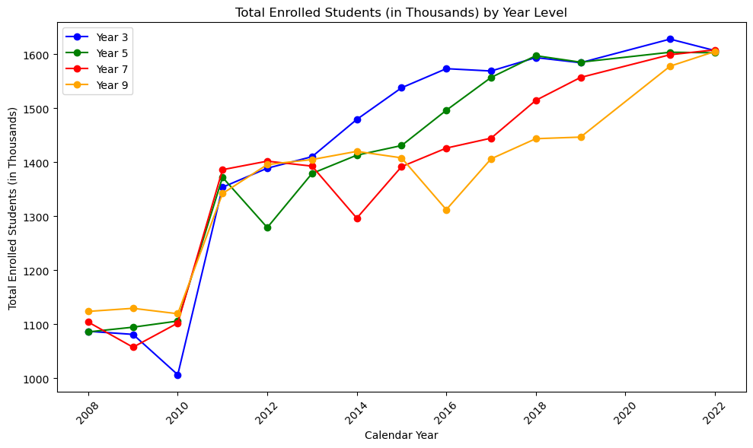
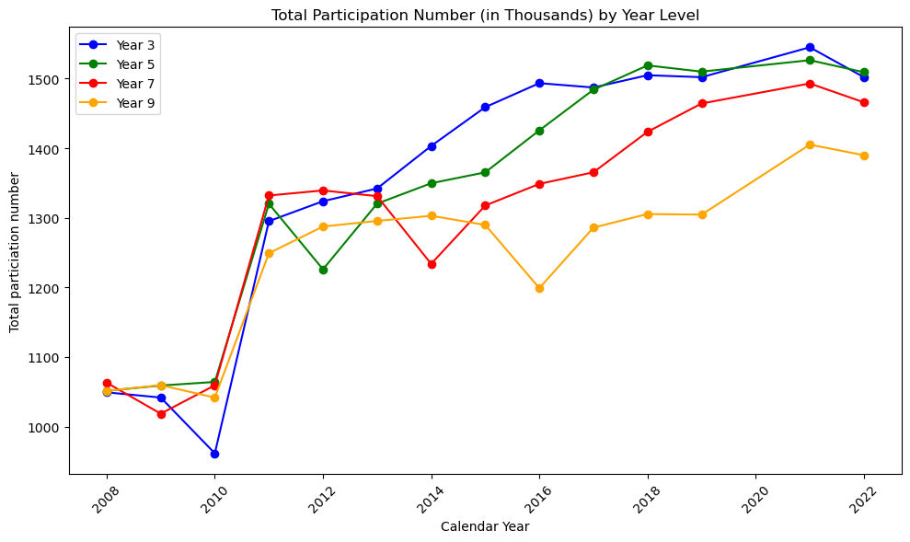
ANALYSIS
6% drop in participation
Notes:
Using the complete Australian data set, we explored trends and found a 6% participation drop.

Slide 7
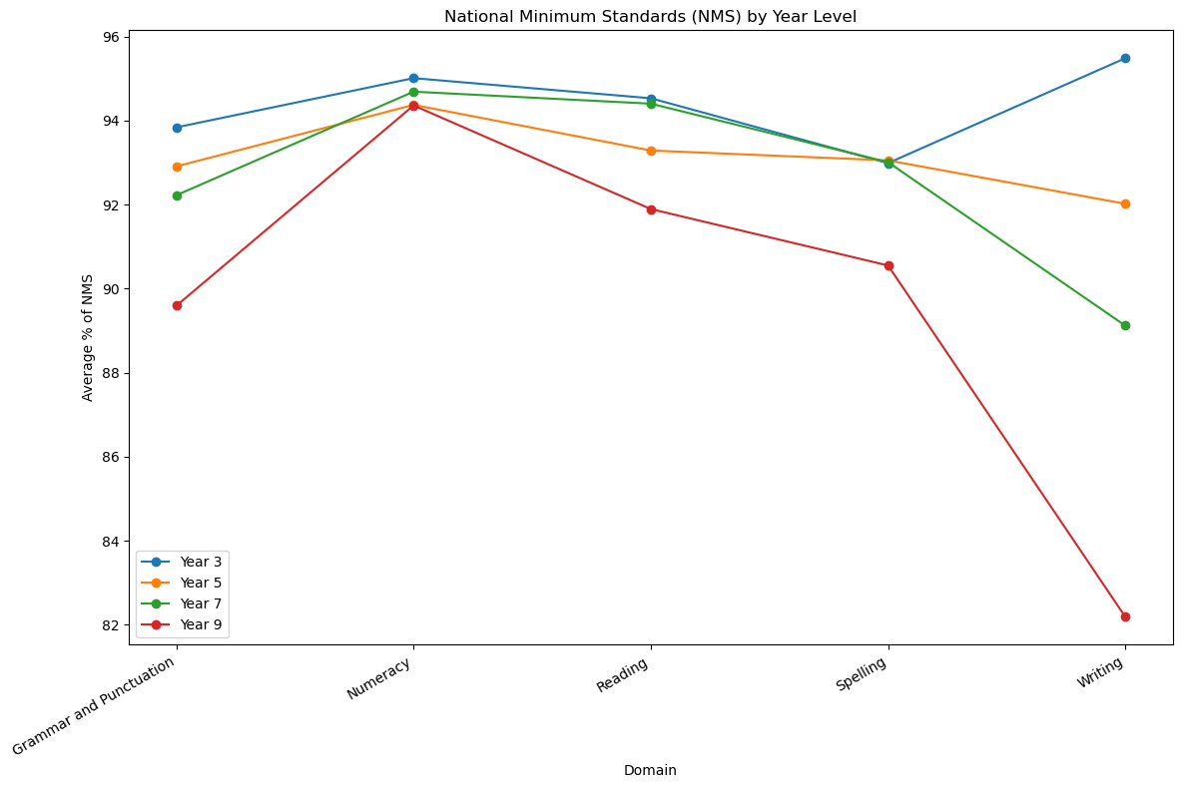
ANALYSIS
Year 9 significantly lower in;
Grammar & punctuation
Reading
Spelling
Writing
Year 7 decline in;
Grammar & punctuation
Writing
Year 3 improved in;
Writing
Notes:
We also observed National Minimum Score trends across domains and grade levels, highlighting numeracy dominance and declining spelling/writing in older year_level.
These became the focus for the Machine learning algorithm. Now over to Minh to showcase the interactive website.

Slide 8
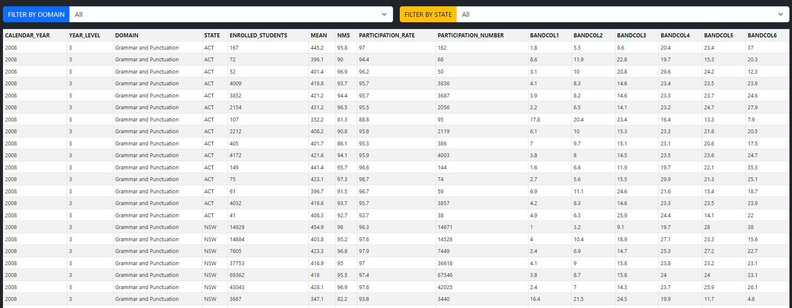
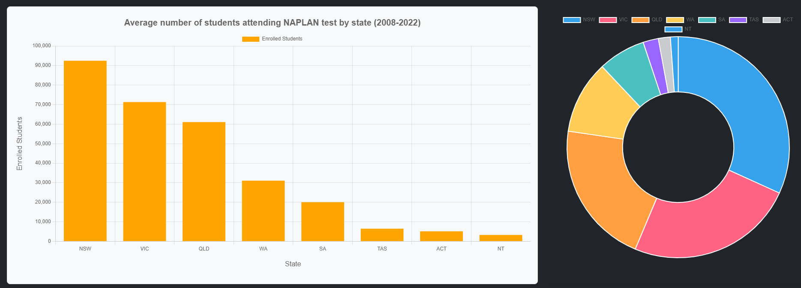
Exploratory Data Analysis
Purpose of the app design
Provide overview of the dataset
Analyze and investigate data sets to provide insights of the NAPLAN test
Notes:
Purpose of the app design:
Provide an overview of the dataset by showing all the information of NAPLAN test from 2008 to 2022, as well as some general insights by using Sort and Filter function.
Analyze and investigate data sets to provide detailed insights and analysis of the NAPLAN test to the audience by using interactive charts and tables.

Slide 9

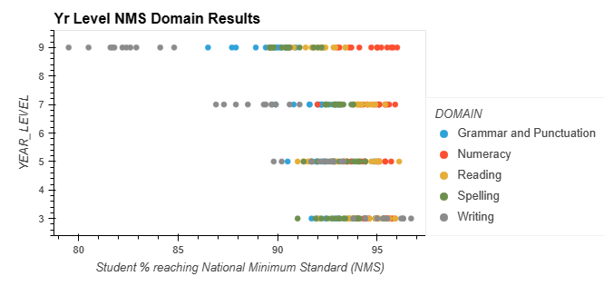
ANALYSIS
SUBGROUPS
Gender
Indigeneity
ABS remoteness
Language background
Parental Education
Parental Occupation
Indigeneity by ABS Remoteness
Notes:
Earlier analysis of the dataset showed negative DOMAIN trends in Yr9 Writing as we mentioned earlier…..
And analysis into SUBGROUPS showed large variations in the % of students reaching the National Minimum Standards
From these initial findings we then focused on specific SUBGROUPS, using Clustering to provide further insights.

Slide 10
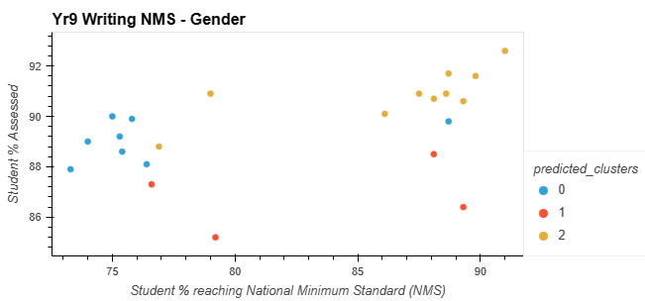
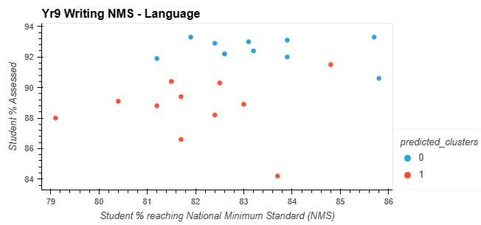
ANALYSIS
SUBGROUPS
Gender
Language
Notes:
Gender Females on average have higher NMS (+~10%)
Language

Slide 11
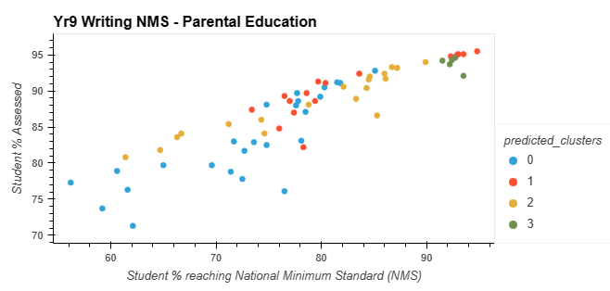
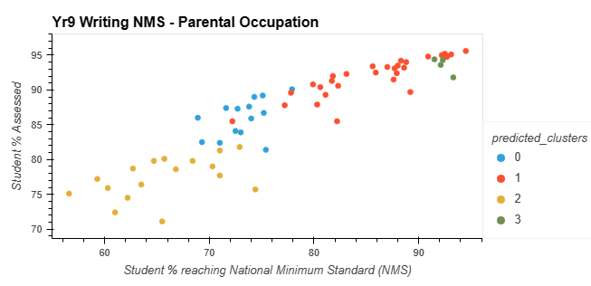
ANALYSIS
SUBGROUPS
Parental Education
Parental Occupation
Notes:
Parental Education
Parental Occupation

Slide 12
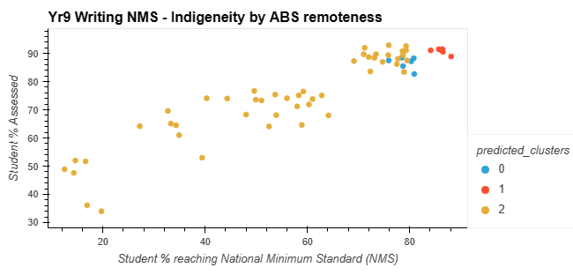
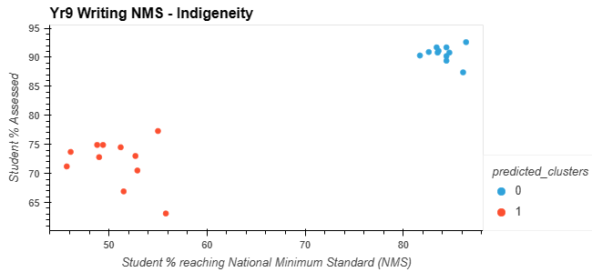
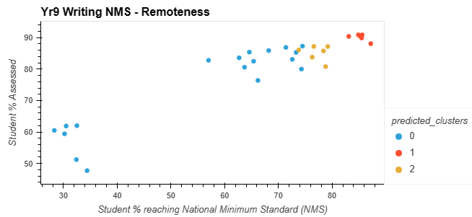
ANALYSIS
SUBGROUPS
Indigeneity
ABS remoteness
Indigeneity by ABS remoteness
Notes:
Indigeneity
indigenous ~51%NMS / ~70% Assessed
non indigenous students ~83%NMS / ~90% Assessed
ABS remoteness
Indigeneity by ABS remoteness Indigeneity

Slide 13
RECCOMENDATIONS
FROM FINDINGS
Equity
Very remote& Indigenous students
Writing in Year 7-9
Participation of remote communities
Assessment levels
Participation levels of all students
FUNDING
SUPPORT MODELS THROUGH SUPERVISION
IMPROVE COMMUNITY / FAMILY PERCEPTION
OTHER FORMS OF DATA COLLECTION
Notes:
Enessa to provide recommendations
Greater funding for remote schools and Indigenous students
Greater funding for schools to embed writing practices with students
Analysis into how to assist children in very remote communities
How do we bump up the assessment level
Gaps in the data
Increase participation in remote areas - all areas positive correlation to achievement standards

Slide 14

QUESTIONS

